Slide 1
Continuous Trait Evolution
Brownian motion, Ornstein-Ulhenbeck and their derivatives
Samantha Price
Bodega Applied Phylogenetics Workshop 2015

Slide 2
OUTLINE
Models of continuous trait evolution
Using simple models of trait evolution
Comparing complex models of continuous trait evolution

Slide 3
OUTLINE
Models of continuous trait evolution: the basics - What are the common models? How do they relate to one another? How can you simulate them?
Using simple models of trait evolution
Comparing complex models of continuous trait evolution

Slide 4
A: Basic Models
Brownian motion
  Simple single rate
Ornstein-Uhlenbeck
  Simple single optima
Early burst/ACDC

Slide 5
Brownian motion

Slide 6
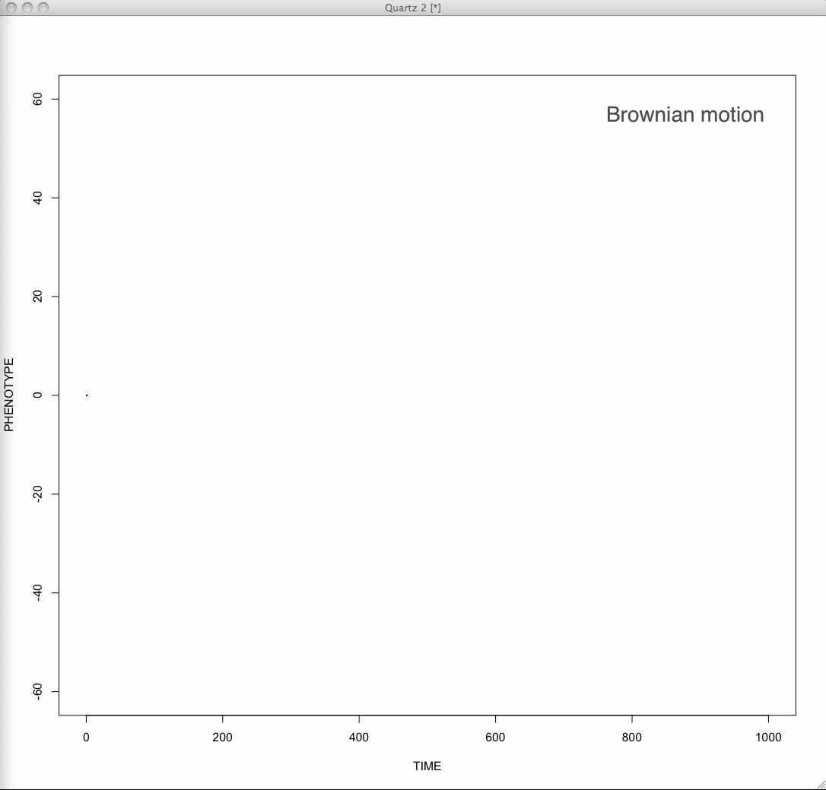
Brownian motion
At a point in time:
A character can increase, decrease or stay the same
Direction and magnitude of change is independent of current or past character states
  Probability of change is drawn from a normal distribution with a mean of 0
Constant rate

Slide 7

Brownian motion
dX_{(t)} = σ dB_{(t)}
Rate
Trait change as
described by
normal distribution
mean = 0
0
Notes:
Lets simulate this most simple case in R. How do we simulate Brownian motion sampling the trajectory of a trait at 100 equidistant points?

Slide 8
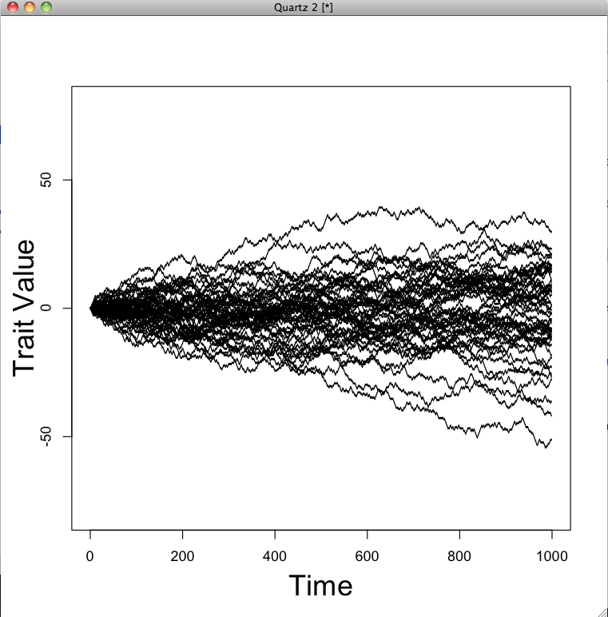
Brownian motion
Variance proportional to time

Slide 9
Brownian motion
dX_{(t)} = σ dB_{(t)}
Rate
Trait change as
described by
normal distribution
mean = 0
SD is related to the Brownian motion rate parameter
0

Slide 10
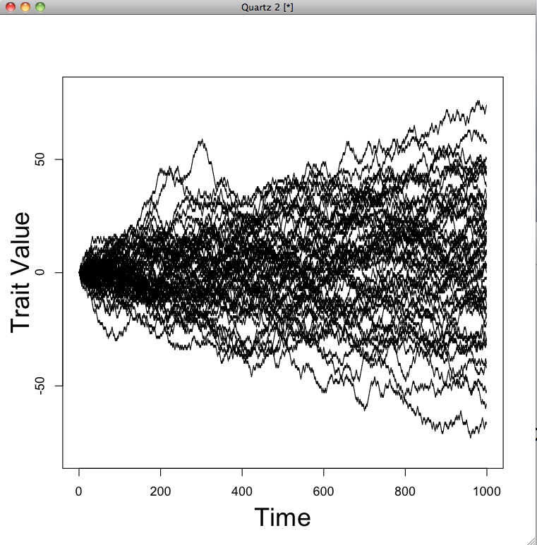
Brownian motion
dX_{(t)} = σ dB_{(t)}
σ = 1
σ = 2
Variance proportional to time and rate

Slide 11
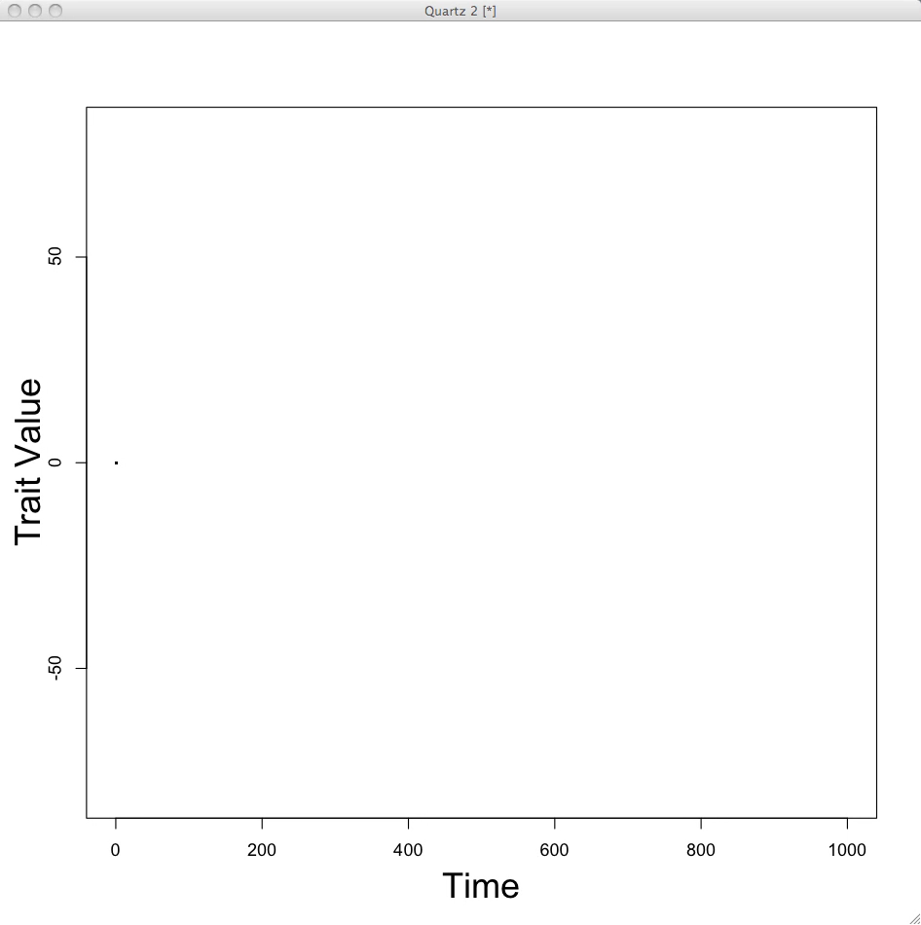
Brownian motion on a phylogeny
Variance proportional to time and rate
Notes:
The grizzly and polar bears share 4 million years share 4 million years of common evolutionary history following exactly the same BM trajectory but 1 million years ago they split and followed independent BM trajectories (with the same mean and rate), this means they have only had 1 million years to accumulate any trait differences. Compare this scenario to that between grizzlies and spectacled bears which last shared a common ancestor ~5 million years ago so the trait of interest is likely to take very different values between these two species as more time has elapsed allowing for more changes to accrue.

Slide 12
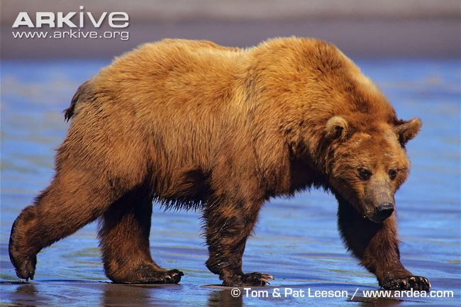
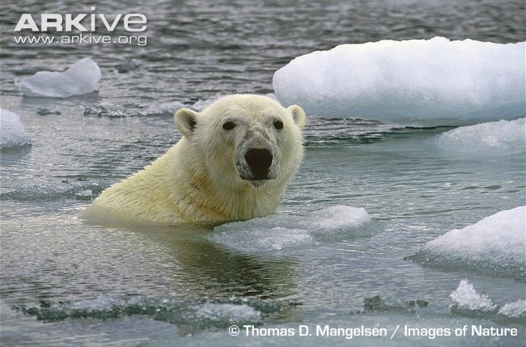
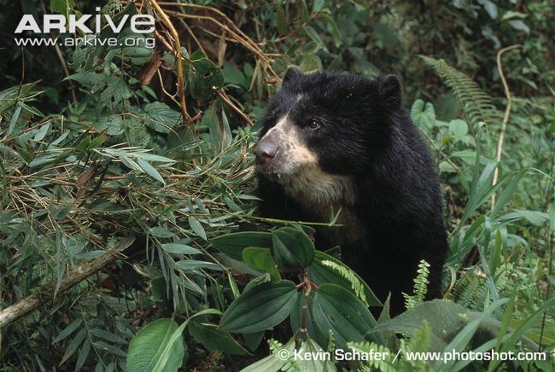
Brownian motion on a phylogeny
Variance proportional to time and rate
dX_{(t)} = σ dB_{(t)}
1 my
4 my
0
SD= √σ²*time
5 my
Notes:
The grizzly and polar bears share 4 million years share 4 million years of common evolutionary history following exactly the same BM trajectory but 1 million years ago they split and followed independent BM trajectories (with the same mean and rate), this means they have only had 1 million years to accumulate any trait differences. Compare this scenario to that between grizzlies and spectacled bears which last shared a common ancestor ~5 million years ago so the trait of interest is likely to take very different values between these two species as more time has elapsed allowing for more changes to accrue.

Slide 13
Brownian motion on a phylogeny
Variance-Covariance matrix
T | s (Shared path length from root) | s
s | T | s
s | s | T
1 my
4 my
5 my
T

Slide 14
Brownian motion on a phylogeny
Variance-Covariance matrix
5 | s (Shared path length from root) | s
s | 5 | s
s | s | 5
1 my
4 my
5 my
T

Slide 15
Brownian motion on a phylogeny
Variance-Covariance matrix
5 | 4 | 0
4 | 5 | 0
0 | 0 | 5
1 my
4 my
5 my

Slide 16
Brownian motion on a phylogeny
Variance-
Covariance
matrix
5 | 4 | 0
4 | 5 | 0
0 | 0 | 5
σ²

Slide 17
How to estimate σ² from tip data?
Maximum likelihood estimator:
σ² = [X-E(X)]’C⁻¹[X-E(X)] N
Tip observations
(column vector)
Expected tip values under BM this is the phylogenetic mean/root state
i.e. (vector)
Phylogenetic Variance-Covariance matrix (not rate modified)
T | s | s
s | T | s
s | s | T
O’Meara et al. 2006 equation 2

Slide 18
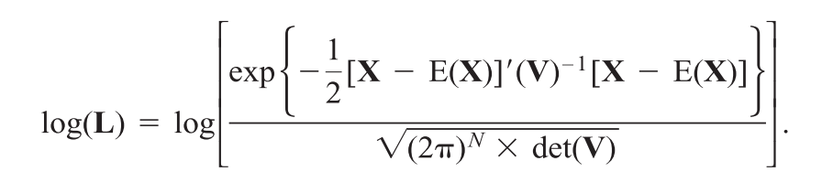
How to estimate σ² from tip data?
Likelihood of the BM model
Tip observations
(column vector)
Expected tip values (vector)
Phylogenetic Variance-Covariance matrix rate modified
T | s | s
s | T | s
s | s | T
σ²
O’Meara et al. 2006 equation 3

Slide 19
Brownian motion with a trend
Including fossils in the phylogeny allows you to test for a trend in a trait over time e.g. Cope’s Rule
dX_{(t)} = σ dB_{(t)}
Rate
Trait change as described by normal distribution mean = ???

Slide 20
Brownian motion with a trend
Including fossils in the phylogeny allows you to test for a trend in a trait over time e.g. Cope’s Rule
dX_{(t)} = σ dB_{(t)}
Rate
Trait change as described by normal distribution mean = μ
Increase μ> 0 >μ decrease

Slide 21
Brownian motion with a trend
μ = 1
μ = -1

Slide 22
Ornstein-Uhlenbeck
Strength of selection
is proportional to distance of
current trait value from optimum
dX_{(t)} = α[θ - X_{(t)}]dt + σdB_{(t)}
Primary optimum
Pull towards optima
(Strength of selection)
Brownian motion
(Brownian motion rate σ² )
Notes:
So this equation should look familiar – A change in trait X over time increment t is described by 3 parameters – theta the optimal trait value, alpha the pull towards the optima and sigma which is the stochastic Brownian rate. You can see that the strength of selection is proportional to the distance of the current trait value X(t) from the optimum – so sometimes alpha is called the rubber band parameter the more you stretch the more it wants to pull back to the middle. What is the primary optimum? It is a theoretical value if multiple independent populations from same ancestor were allowed infinite time to evolve under the same selective regime it is the average adaptive optimum reached by these populations – it relfects the influence of the selective factor against a maximally randomized background.

Slide 23
Ornstein-Uhlenbeck = Brownian motion when α is 0
dX_{(t)} = 0[θ - X_{(t)}]dt + σdB_{(t)}
Brownian motion
Notes:
You can also see that when the pull towards the peak is 0 you default to simple Brownian motion, so it is a special case of OU.

Slide 24
Ornstein-Uhlenbeck = Brownian motion when α is 0
dX_{(t)} = α[θ - X_{(t)}]dt + σdB_{(t)}
Brownian motion
Notes:
You can also see that when the pull towards the peak is 0 you default to simple Brownian motion, so it is a special case of OU.

Slide 25
dX_{(t)} = α[θ - X_{(t)}]dt + σdB_{(t)}
Trait Value
θ = 1, α = 0.1, σ = 0.01
θ = 2, α = 0.1, σ = 0.01
Time
Time
Notes:
So what about when alpha is greater than 0? So theta is really simple as that is the optima so the trait starts at zero and is then pulled towards it fairly rapidly, once it has reached it it moves stochastically around the optima each time if it goes to far getting pulled back in.

Slide 26
dX_{(t)} = α[θ - X_{(t)}]dt + σdB_{(t)}
Trait Value
θ = 1, α = 0.1, σ = 0.01
θ = 1, α = 0.8, σ = 0.01
Time
Time
Stronger α the more quickly the optima is reached and the lower variance
Notes:
With alpha, you should notice two things, the stronger the alpha the more quickly the optima is reached and there is lower variance around that optima.

Slide 27
dX_{(t)} = α[θ - X_{(t)}]dt + σdB_{(t)}
Trait Value
θ = 1, α = 0.1, σ = 0.01
θ = 1, α = 0.1, σ = 0.1
Time
Time
Higher σ the greater the variance
Notes:
So what happens when we increase sigma? You are increasing the variance around the optima. So what happens when we increase both sigma and alpha?

Slide 28
dX_{(t)} = α[θ - X_{(t)}]dt + σdB_{(t)}
Variance in trait due to α and σ
θ = 1, α = 0.1, σ = 0.01
θ = 1, α = 0.8, σ = 0.01
θ = 1, α = 0.1, σ = 0.1
θ = 1, α = 0.8, σ = 0.1
Notes:
Reach the optima more rapidly and variance is intermediate, so under the flexible OU model the variance in the trait is due to both alpha and sigma. But remember we are estimating these rates using the variance of the trait on the tips of the tree – so are alpha and sigma identifiable?

Slide 29
dX_{(t)} = α[θ - X_{(t)}]dt + σdB_{(t)}
Are σ and α identifiable? As a decrease in rate (σ²) and an increase in α both reduce variance of the trait at the tips of the tree.

Slide 30
dX_{(t)} = α[θ - X_{(t)}]dt + σdB_{(t)}
Are σ and α identifiable? As a decrease in rate (σ²) and an increase in α both reduce variance of the trait at the tips of the tree.
Yes (theoretically) an increase in α will erode the phylogenetic pattern of the trait but a decrease in σ² will not.
However there will be cases where various estimates σ of and α are equally likely.

Slide 31
OU on a phylogeny
Variance-
Covariance
matrix
1 - e^{-2αT} | e^{-2α(T-s)}(1 – e^{-2αs}) | e^{-2α(T-s)}(1 – e^{-2αs})
e^{-2α(T-s)}(1 – e^{-2αs}) | 1 - e^{-2αT} | e^{-2α(T-s)}(1 – e^{-2αs})
e^{-2α(T-s)}(1 – e^{-2αs}) | e^{-2α(T-s)}(1 – e^{-2αs}) | 1 - e^{-2αT}
σ²/2α
T is the path length root to tip
s is the shared path length
Butler & King 2004

Slide 32
OU on a phylogeny
Variance-
Covariance
matrix
α = 0.1
σ² = 1
1 - e^{-2αT} | e^{-2α(T-s)}(1 – e^{-2αs}) | e^{-2α(T-s)}(1 – e^{-2αs})
e^{-2α(T-s)}(1 – e^{-2αs}) | 1 - e^{-2αT} | e^{-2α(T-s)}(1 – e^{-2αs})
e^{-2α(T-s)}(1 – e^{-2αs}) | e^{-2α(T-s)}(1 – e^{-2αs}) | 1 - e^{-2αT}
T = 5
α = 0.1
T = 5, s = 4
α = 0.1
T = 5, s = 0
α = 0.1
σ²/2α
T = 5, s = 4
α = 0.1
T = 5
α = 0.1
T = 5, s = 0
α = 0.1
T is the path length root to tip
s is the shared path length
T = 5, s = 0
α = 0.1
T = 5
α = 0.1
T = 5, s = 0
α = 0.1

Slide 33
OU on a phylogeny
Variance-
Covariance
matrix
α = 0.1
σ² = 1
0.632 | 0.451 | 0
0.451 | 0.632 | 0
0 | 0 | 0.632
σ²/2α
1/(2*0.1)
T is the path length root to tip
s is the shared path length

Slide 34
OU on a phylogeny
Variance-
Covariance
matrix
α = 0.1
σ² = 1
3.16 1/(2*0.1)*0.632 | 2.25 1/(2*0.1)*0.451 | 0 1/(2*0.1)*0
2.25 | 3.16 | 0
0 | 0 | 3.16

Slide 35
Early (AC) or Late burst (DC)
Accelerating (AC) or declining (DC) net rates through time:
Early burst - greatest phenotypic divergence early -> net rate slows over time (e.g. niche-filling or adaptive radiation model).
Late burst – greatest phenotypic divergence late -> net rate increases over time

Slide 36
Early or Late burst
Modeled as a Brownian process with an exponential change in net rate over time
Rate = σ²0 * e^{(-rt)}
Initial rate
Exponential change in rate over time

Slide 37
Early or Late burst

Slide 38
Early and Late bursts on a phylogeny
Early Burst
Late Burst

Slide 39
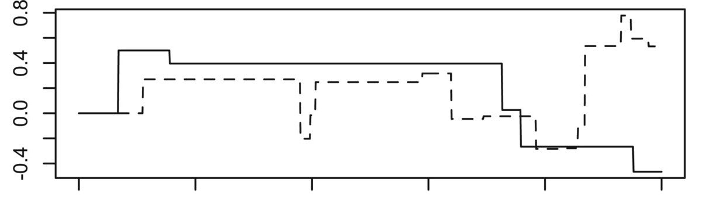
Additional Continuous trait Models on Phylogenies
Optima and/or rates vary across the phylogeny – see section C!
Lévy process: 3 components BM, trend and jump so can model ‘punctuated evolution’ (see Landis, Schraiber et al. 2013)
Normally distributed jumps
Trend (μ) = 0
BM (σ²) = 0
Trait Value
Time

Slide 40
OUTLINE
Basic models of continuous trait evolution
Using simple models of trait evolution: starting to investigate the evolutionary patterns within your data through independent contrasts, model-fitting & visualization
Comparing complex models of continuous trait evolution

Slide 41
B: Using simple models
Independent contrasts
Phylogenetic signal
Visualizing trait evolution on the phylogeny
Fitting BM, OU & EB models

Slide 42
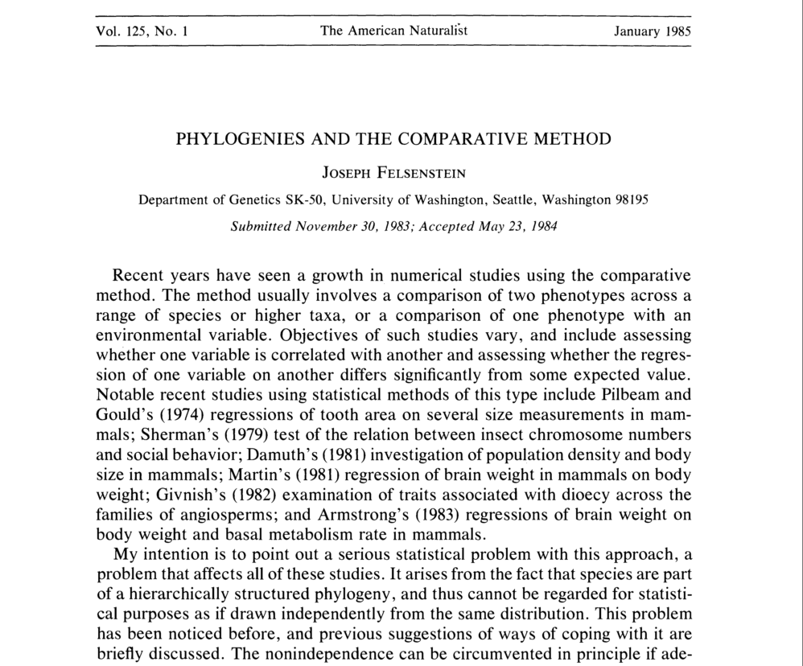
1: Independent Contrasts
Felsenstein 1985

Slide 43
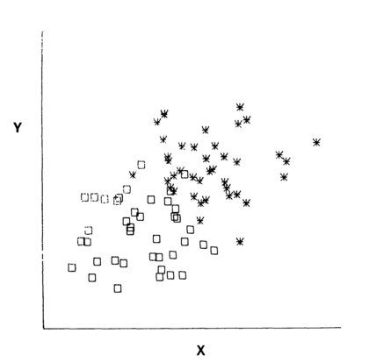
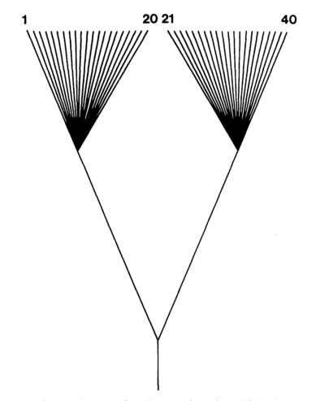
1: Independent Contrasts
The problem

Slide 44
1: Independent Contrasts
The solution: Independent contrasts
  Brownian motion model to include in the age since MRCA: variance is proportional to time.
Y = 7 9 3
A
B
C
Binary 3 species tree there are two independent contrasts
2
k
4
2

Slide 45
1: Independent Contrasts
The solution: Independent contrasts
 | Contrast | Raw PIC | Branch length L | Branch length R | SD (√ L+R branch length) | Standardized contrast
A - B | 9 - 7 | 2 | 2 | 1 | 2 | 0.5
Y = 9 7 3
A
B
C
2
k
4
2

Slide 46
1: Independent Contrasts
The solution: Independent contrasts
 | Contrast | Raw PIC | Branch length L | Branch length R | SD (√ L+R branch length) | Standardized contrast
A - B | 9 - 4 | 5 | 2 | 2 | 2 | 2.5
k - C
k =
Y = 9 5 3
A
B
C
(1/RdaughterBL*RdaughterY) + (1/LdaughterBL*LdaughterY)
(1/RdaughterBL) + (1/LdaughterBL)
2
k
4
(1/2*9) + (1/2*4)
= 6.5
2
(1/2) + (1/2)

Slide 47
1: Independent Contrasts
The solution: Independent contrasts
 | Contrast | Raw PIC | Branch length L - corrected | Branch length R | SD (√ L+R branch length) | Standardized contrast
A - B | 9 - 7 | 2 | 2 | 1 | 2 | 0.5
k - C | 6.5 - 3 | 3.5 |  | 4
Branch length correction =
Y = 9 7 3
A
B
C
RdaughterBL*LdaughterBL
2*2
RdaughterBL + LdaughterBL
2+2
2
6.5
4
2
Notes:
As we go down the tree we are using more and more inferred values and thus we want to devalue, this is done by lengthening the branches leading to internal nodes

Slide 48
1: Independent Contrasts
The solution: Independent contrasts
 | Contrast | Raw PIC | Branch length L - corrected | Branch length R | SD (√ L+R branch length) | Standardized contrast
A - B | 9 - 7 | 2 | 2 | 1 | 2 | 0.5
k - C | 6.5 - 3 | 3.5 | 3 | 4 | 2.645 | 1.323
Branch length correction =
Y = 9 7 3
A
B
C
RdaughterBL*LdaughterBL
2*2
= 1
RdaughterBL + LdaughterBL
2+2
2
6.5
4
2
Notes:
As we go down the tree we are using more and more inferred values and thus we want to devalue, this is done by lengthening the branches leading to internal nodes

Slide 49
1: Independent Contrasts
The solution: Correlation/regression of Independent contrasts
  All analyses with PIC must be forced through the origin (because the sign of the contrasts is arbitrary). So, if you want to do run a PCA on PIC’s you have to mirror the contrasts.
Notes:
As we go down the tree we are using more and more inferred values and thus we want to devalue, this is done by lengthening the branches leading to internal nodes

Slide 50
1- 4: Tutorial
Demonstration: how to run independent contrasts in ape, fit simple BM, OU & Early/Late Burst models in geiger and use traitgrams, phylomorphospaces in phytools to visualize trait evolution.
Exercise: using these skills and everything you have learnt about the various evolutionary models, investigate the 4 traits in the traitsx.txt files and identify their evolutionary models.

Slide 51
Exercise Results: Model-fitting Trait 1
Notes:
(BM)

Slide 52
Exercise Results: Model-fitting Trait 1
Weak support for
BM

Slide 53
Exercise Results: Model-fitting
ΔAIC: MEDIAN & 95%CI
 | BM | OU | EB
Trait 1 | 0 (0 – 2.5) | 1.9 (0 – 2.4) | 1.3 (0 – 2.1)
Trait 2
Trait 3
Trait 4

Slide 54
Exercise Results: Model-fitting Trait 2
Notes:
(OU)

Slide 55
Exercise Results: Model-fitting Trait 2
Strong support for OU/EB, which are indistinguishable

Slide 56
Exercise Results: Model-fitting Trait 2
Late burst: exponential rate change > 0
Pull towards the peak is not weak

Slide 57
Exercise Results: Model-fitting
ΔAIC: MEDIAN & 95%CI
 | BM | OU | EB
Trait 1 | 0 (0 – 2.5) | 1.9 (0 – 2.4) | 1.3 (0 – 2.1)
Trait 2 | 86 (52 – 114) | 0 (0 - 1.5e⁻¹²) | 2.6e⁻¹³ (0 - 8.3e⁻⁰³)
Trait 3
Trait 4
LATE BURST

Slide 58
Exercise Results: Model-fitting Trait 3
Strong support for EB
Notes:
(EB)

Slide 59
Exercise Results: Model-fitting Trait 3
Early burst: exponential rate change < 0

Slide 60
Exercise Results: Model-fitting
ΔAIC: MEDIAN & 95%CI
 | BM | OU | EB
Trait 1 | 0 (0 – 2.5) | 1.9 (0 – 2.4) | 1.3 (0 – 2.1)
Trait 2 | 86 (52 – 114) | 0 (0 - 1.5e⁻¹²) | 2.6e⁻¹³ (0 - 8.3e⁻⁰³)
Trait 3 | 126 (64 – 211) | 128 (66 – 213) | 0 (0 – 0)
Trait 4
LATE BURST
EARLY BURST

Slide 61
Exercise Results: Model-fitting Trait 4
0
2e⁻⁸
Notes:
(LB)

Slide 62
Exercise Results: Model-fitting Trait 4
Strong support for OU/EB, which are indistingu-ishable
0
2e⁻⁸

Slide 63
Exercise Results: Model-fitting
ΔAIC: MEDIAN & 95%CI
 | BM | OU | EB
Trait 1 | 0 (0 – 2.5) | 1.9 (0 – 2.4) | 1.3 (0 – 2.1)
Trait 2 | 86 (52 – 114) | 0 (0 - 1.5e⁻¹²) | 2.6e⁻¹³ (0 - 8.3e⁻⁰³)
Trait 3 | 126 (64 – 211) | 128 (66 – 213) | 0 (0 – 0)
Trait 4 | 21 (12 – 32) | 1.5e⁻⁸ (2e⁻¹¹ – 9e⁻⁸) | 0 (0 – 2.8e⁻¹¹)
LATE BURST
EARLY BURST
LATE BURST

Slide 64
Exercise Results: Model-fitting
 | BM | OU | EB
Trait 1 | ? | ? | ?
Trait 2 | X | ? | ?
Trait 3 | X | X | ✓ Early
Trait 4 | X | ? | ?
LATE
LATE

Slide 65
Exercise Results: Trait 1
Very weak alpha: when alpha = 0 -> BM
Very gradual speed up or slow down!
Notes:
(BM)

Slide 66
Exercise Results: Model-fitting
 | BM | OU | EB
Trait 1 | ✓ | X | X
Trait 2 | X | ? | ?
Trait 3 | X | X | ✓ Early
Trait 4 | X | ? | ?
LATE BURST
LATE BURST
Notes:
So we can infer BM, if we wanted to be sure we could simulate under the various models and compare the parameter estimates we get

Slide 67
Exercise Results: Trait 2
Root
Present
Present
Root

Slide 68
Exercise Results: Trait 4
Root
Present
Present
Root

Slide 69
Exercise Results: Trait 2 & 4
Highly constrained phenotype
High phenotypic variance
3
200
0
x2
x4
-400
Root
Present
Root
Present

Slide 70
Exercise Results: Model-fitting
 | BM | OU | EB
Trait 1 | ✓ | X | X
Trait 2 | X | ✓ | ?
Trait 3 | X | X | ✓ Early
Trait 4 | X | ? | ✓ Late
OU and Late Burst/Accelerating evolution are indistinguishable using likelihood*
* Which probably explains why the default in geiger is to only fit an early burst not a late burst model.
Notes:
So we can infer BM, if we wanted to be sure we could simulate under the various models and compare the parameter estimates we get

Slide 71
Exercise Results: Model-fitting
 | BM | OU | EB
Trait 1 | ✓ | X | X
Trait 2 | X | ✓ | ?
Trait 3 | X | X | ✓ Early
Trait 4 | X | ? | ✓ Late
Even harder with empirical data – where are your comparisons? How can you identify what is highly constrained or not? A) Out-groups? B) Simulations: can you generate the patterns you are seeing? can you start to rule out alternatives?
Notes:
So we can infer BM, if we wanted to be sure we could simulate under the various models and compare the parameter estimates we get

Slide 72
OUTLINE
Basic models of continuous trait evolution
Using simple models of trait evolution & independent contrasts
Comparing complex models of continuous trait evolution: multi-rate and multi-peak models.

Slide 73
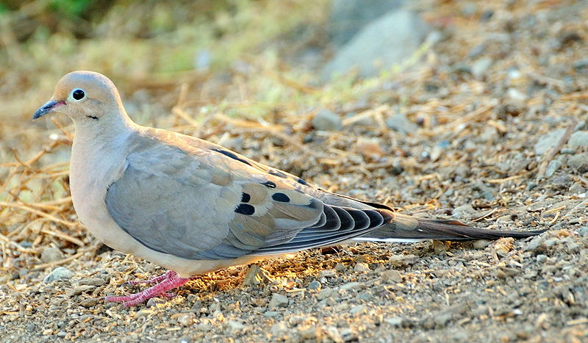
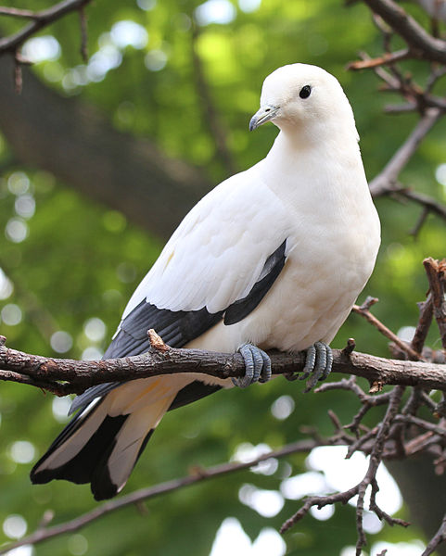
C: Multi-rate & Peak Models
Does changing from terrestrial to arboreal foraging lead to changes in hind limb and tail morphology in pigeons and doves?
(Lapiedra et al. 2013, Proc. Roy. Soc. 280)
Notes:
This approach has been used to answer questions as varied as

Slide 74
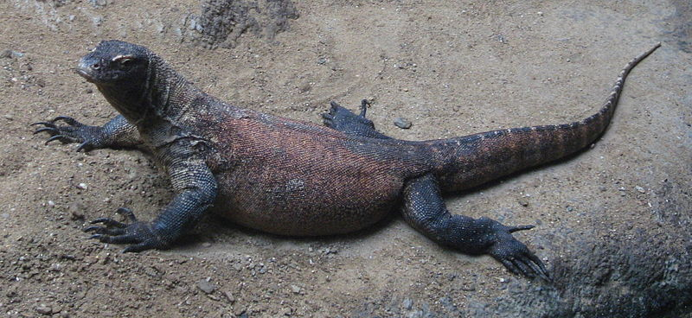
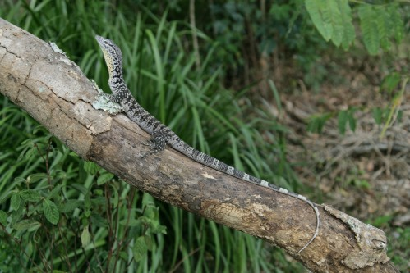
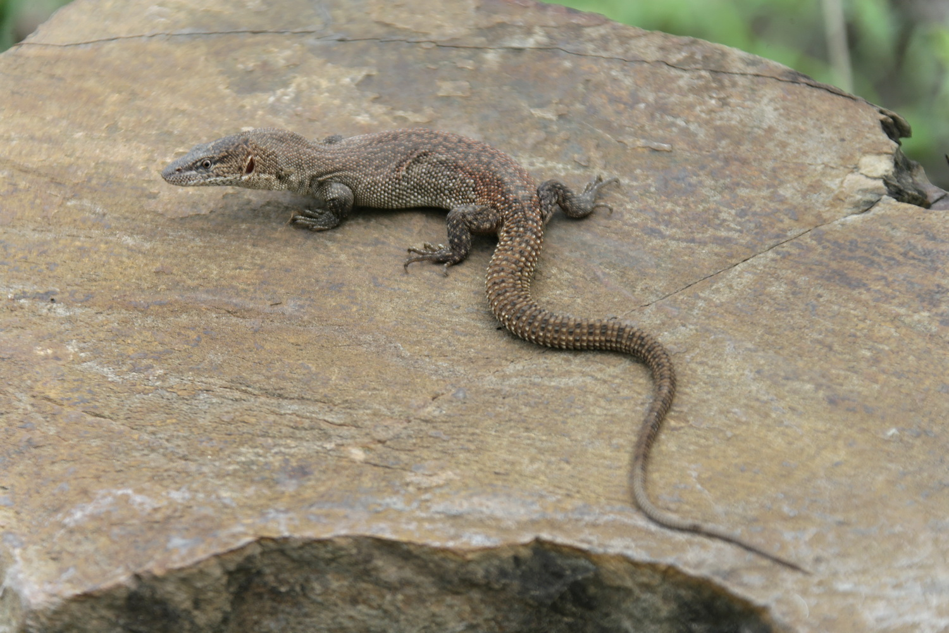
C: Multi-rate & Peak Models
Do changes in habitat use lead to changes in body size and shape in monitor lizards?
(Collar et al. 2011 Evolution 65(9), 2664-2680)
Notes:
This approach has been used to answer questions as varied as

Slide 75
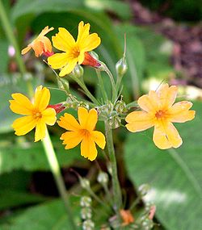
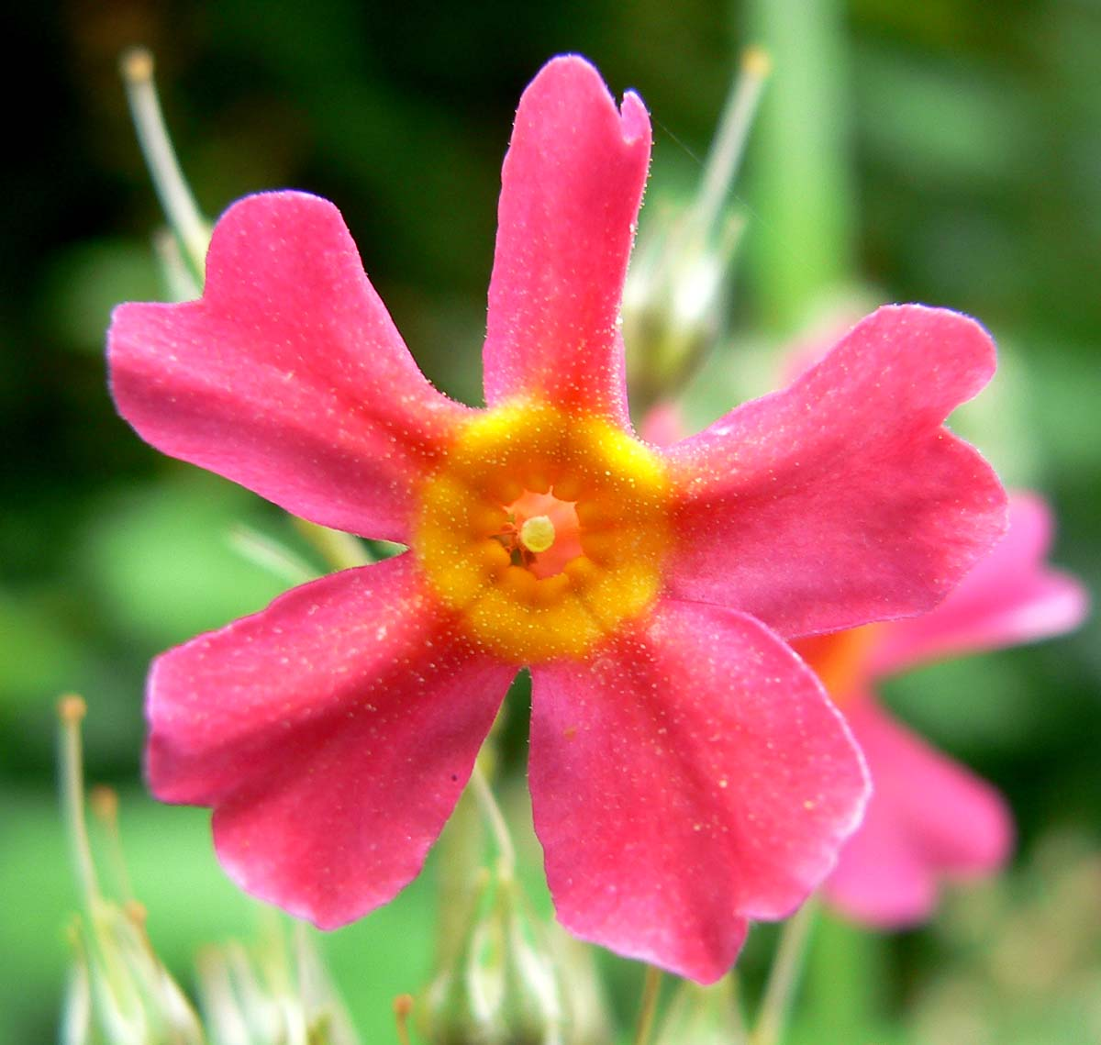
C: Multi-rate & Peak Models
Does the loss of heterostyly lead to changes in floral morphology in primroses ?
de Vos et al. 2014 Evolution
Notes:
So I am guessing that many of you have questions like this in your favourite clades. In general we can think about a change

Slide 76
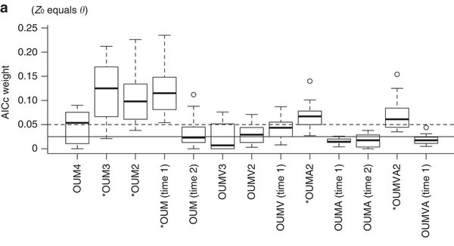
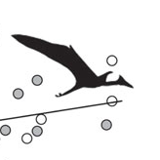
C: Multi-rate & Peak Models
Do pterodactyloids have larger optimal body sizes than non-pterodactyloids?
Benson et al. 2014 Nature
Notes:
So I am guessing that many of you have questions like this in your favourite clades. In general we can think about a change

Slide 77
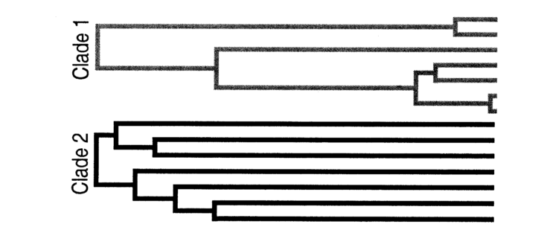
  σ² and disparity on a tree
If we simulate a single Brownian motion on these 2 clades (e.g. σ²=0.5) , which have same age and same number of tips, will they have the same variance at the tips (disparity)? And if not, which one do you think will be greater and why?

Slide 78
  σ² and disparity on a tree
If we simulate a single Brownian motion on these 2 clades (e.g. σ²=0.5) , which have same age and same number of tips, will they have the same variance at the tips (disparity)? And if not, which one do you think will be greater and why?

Slide 79
  σ² and disparity on a tree
If we calculate the trait variance of clade 1 and 2 and get the same variance estimates, would you estimate the same σ²? And if not, which one do you think will be greater and why?

Slide 80
  σ² and disparity on a tree
If we calculate the trait variance of clade 1 and 2 and get the same variance estimates, would you estimate the same σ²? And if not, which one do you think will be greater and why?

Slide 81
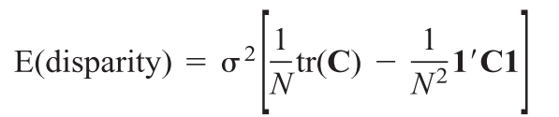
  σ² and disparity on a tree
Number
of tips
Phylogenetic Variance-Covariance matrix (not rate modified)
T | s | s
s | T | s
s | s | T
O’Meara et al. 2006: Equation 1 derived in appendix

Slide 82
Different σ² on different branches
σ²_{a}
σ²_{b}

Slide 83
Different σ² on different branches
Phenotype
Single rate BM
σ²=0.1
σ²=0.1

Slide 84
Different σ² on different branches
Phenotype
Phenotype
Single rate BM
σ²=0.1
σ²=0.1
Two-rate BM???
σ²=0.1
σ²=1
Time

Slide 85
Different σ² on different branches
Phenotype
Phenotype
Single rate BM
σ²=0.1
σ²=0.1
Two-rate BM
σ²=0.1
σ²=1
Time

Slide 86
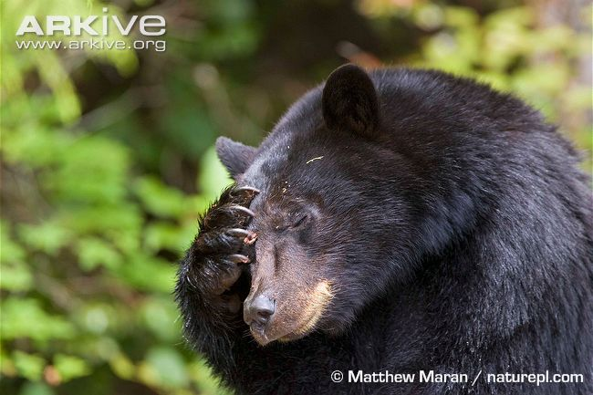
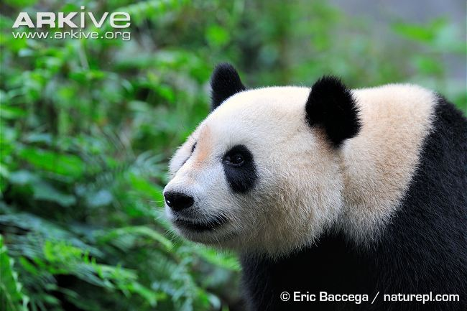
Different σ² on different branches
1 my
5 my
4 my
σ_{a}²
8 my
3 my
σ_{b}²
28 my
20 my

Slide 87
Different σ² on different branches
1 my
5 my
4 my
σ_{a}²
8 my
3 my
T | s | s
s | T | s
s | s | T
σ_{b}²
28 my
20 my
σ²

Slide 88
2-rate Brownian VCV
5σ_{a}² + 23σ_{b}² | 4σ_{a}² + 23σ_{b}² | 23σ_{b}² | 20σ_{b}² | 0
4σ_{a}² + 23σ_{b}² | 5σ_{a}² + 23σ_{b}² | 23σ_{b}² | 20σ_{b}² | 0
23σ_{b}² | 23σ_{b}² | 28σ_{b}² | 20σ_{b}² | 0
20σ_{b}² | 20σ_{b}² | 20σ_{b}² | 28σ_{b}² | 0
0 | 0 | 0 | 0 | 28σ_{b}²

Slide 89
  Estimate log(L) of each model
1-rate VCV
2-rate VCV
28σ² | 27σ² | 23σ² | 20σ² | 0
27σ² | 28σ² | 23σ² | 20σ² | 0
23σ² | 23σ² | 28σ² | 20σ² | 0
20σ² | 20σ² | 20σ² | 28σ² | 0
0 | 0 | 0 | 0 | 28σ²
5σ_{a}² + 23σ_{b}² | 4σ_{a}² + 23σ_{b}² | 23σ_{b}² | 20σ_{b}² | 0
4σ_{a}² + 23σ_{b}² | 5σ_{a}² + 23σ_{b}² | 23σ_{b}² | 20σ_{b}² | 0
23σ_{b}² | 23σ_{b}² | 28σ_{b}² | 20σ_{b}² | 0
20σ_{b}² | 20σ_{b}² | 20σ_{b}² | 28σ_{b}² | 0
0 | 0 | 0 | 0 | 28σ_{b}²

Slide 90
Different θ, α and/or σ on different branches
Phenotype
Single rate BM
σ²=0.1
σ²=0.1
Two-optima????
θ=1
θ=3
Time

Slide 91
Different θ, α and/or σ on different branches
Phenotype
Phenotype
Single rate BM
σ²=0.1
σ²=0.1
Two-optima
θ=1
θ=3
Time

Slide 92
Different θ, α and/or σ on different branches
Phenotype
Phenotype
Two-optima
Two rubber-bands???
θ=1, α=1
θ=3, α=0.2
Two-optima
θ=1, α=0.5
θ=3, α=0.5
Time

Slide 93
Different θ, α and/or σ on different branches
Phenotype
Phenotype
Two-optima
Two rubber-bands
θ=1, α=1
θ=3, α=0.2
Two-optima
θ=1, α=0.5
θ=3, α=0.5
Time

Slide 94
Different θ, α and/or σ on different branches
Phenotype
Two-optima
θ=1, α=0.5
θ=3, α=0.5
Two-optima
Two-rates ?????
θ=1, σ²=0.1
θ=3, σ²=1

Slide 95
Different θ, α and/or σ on different branches
Phenotype
Two-optima
θ=1, α=0.5
θ=3, α=0.5
Two-optima
Two-rates
θ=1, σ²=0.1
θ=3, σ²=1

Slide 96
Different θ, α and/or σ on different branches in different states
1 my
5 my
4 my
θ_{a}/α_{a}/σ_{a}
8 my
3 my
θ_{b}/α_{b}/σ_{b}
28 my
20 my
Character histories can be generated using make.simmap in phytools

Slide 97
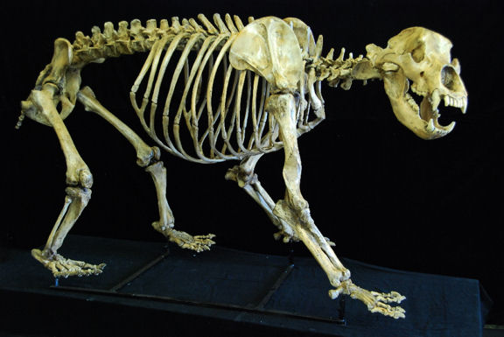
Different θ, α and/or σ in different time periods
θ_{a}/α_{a}/σ_{a}
θ_{b}/α_{b}/σ_{b}
Time slice histories can be generated with make.era.map in phytools

Slide 98
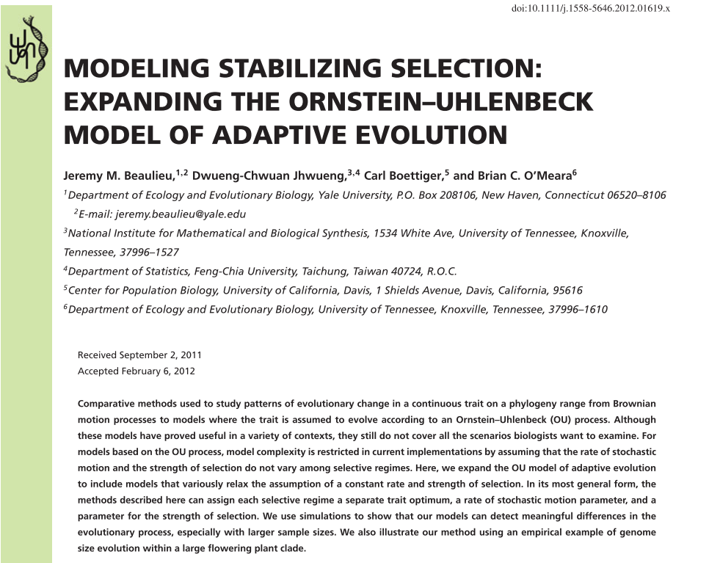
Different θ, α and/or σ on different branches: OUwie
Model | θ | σ | α
BM1 | - | Universal | -
OU1 | Universal | Universal | Universal
BMS | - | Variable | -
OUM | Variable | Universal | Universal
OUMA | Variable | Universal | Variable
OUMV | Variable | Variable | Universal
OUMVA | Variable | Variable | Variable

Slide 99
Model Comparison
Model-fitting
Use AICc or Likelihood ratio tests (with parametric bootstrapping) to determine which of the models fits the data best.
Model-averaging
Calculate Akaike weights from the log likelihood and use them to average the parameters among all models weighted by the support for each model – be careful when combining BM & OU…

Slide 100
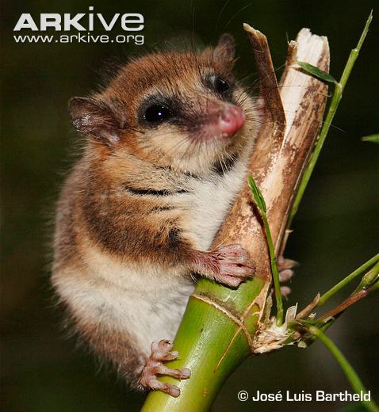
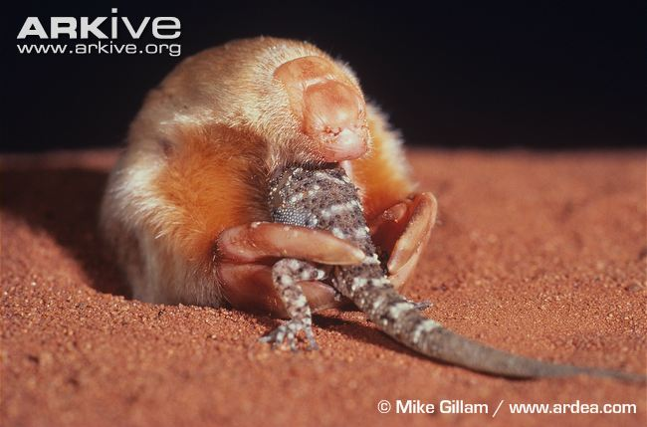
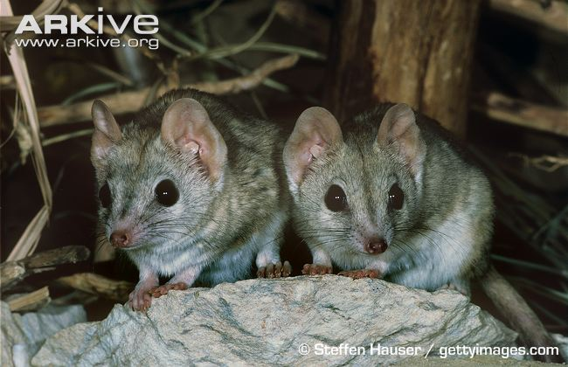
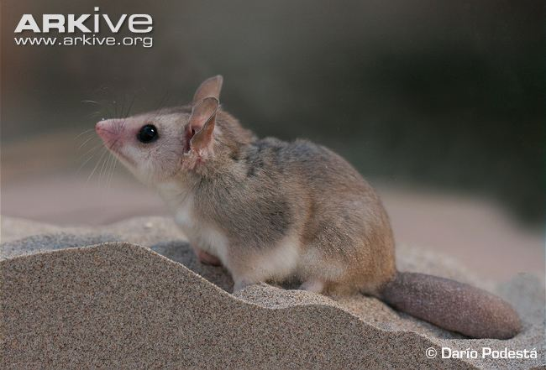
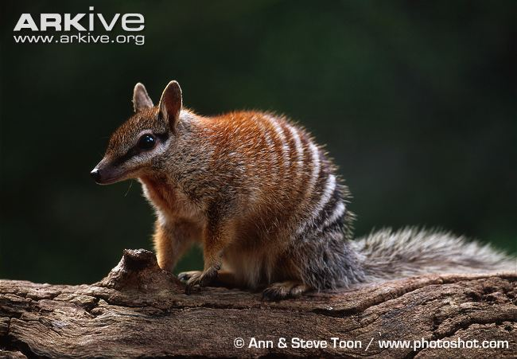
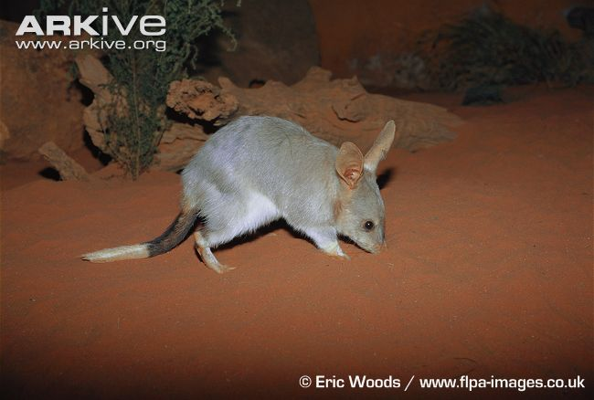
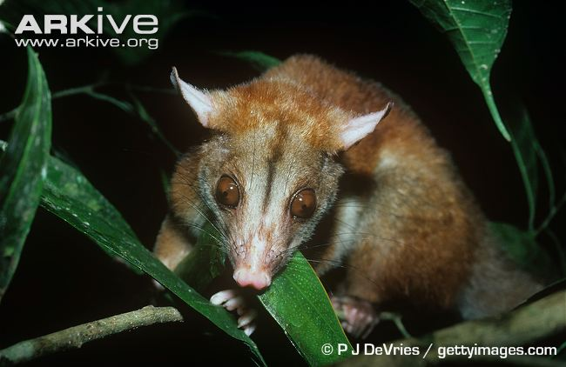
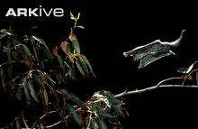
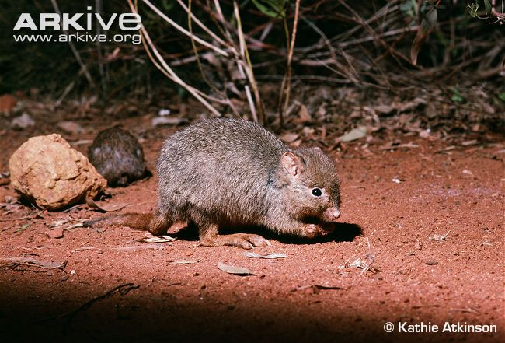
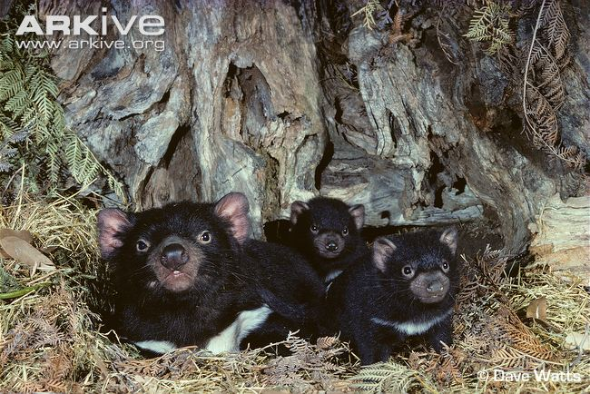
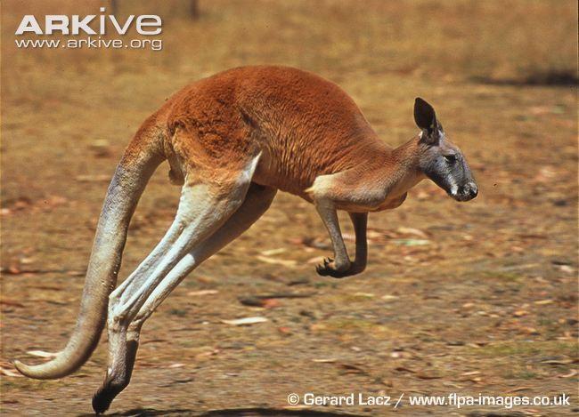
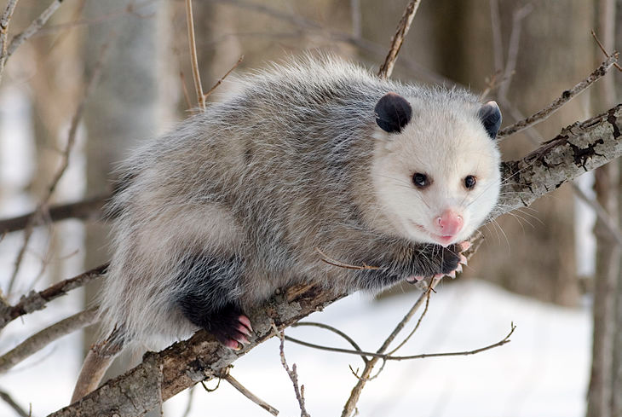
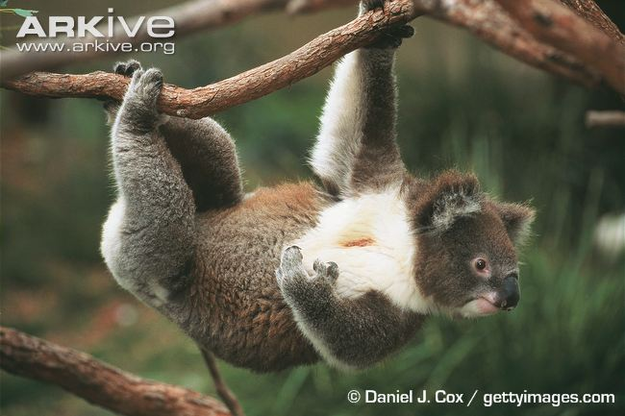
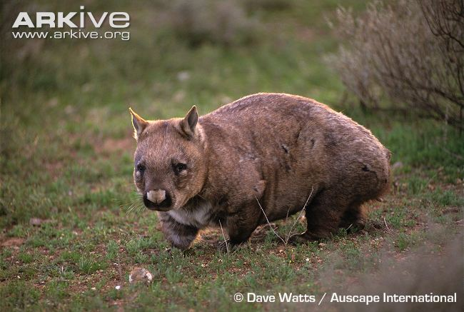
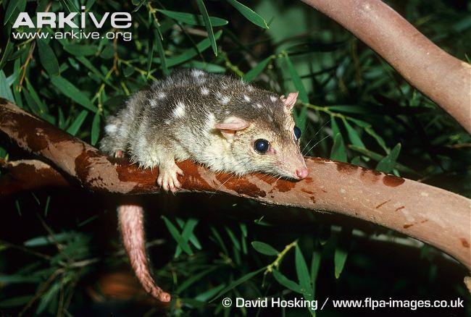
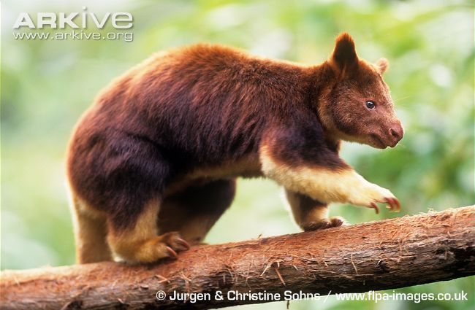

Slide 101
Hypothesis: Diet influences body size evolution such that herbivores have the highest optimal mass
If this hypothesis is true, predict
Which parameters (θ, α and/or σ) you expect to be influenced and how?
Which models (BM1, OU1, BMS, OUM, OUMA, OUMV) will fit the data best?
Notes:
Go work through this on your own or grab a coffee etc.

Slide 102
Practical Considerations
Number of regimes/parameters estimated vs number taxa
  Investigate this using parametric bootstrapping approaches (Ouwie has a simulation function that really helps with this).
Evenness of species number in each regime

Slide 103
Practical Considerations
Computational time: To run an analysis on a reasonably sized dataset with multiple character histories per tree topology can take many days
  Access to high performance computing
    Many universities have a cluster
    Free online access to clusters for particular analyses/taxa e.g. iplant discovery environment
    Pay to use cloud computing e.g. Amazon EC2
  Batch processing your analyses – running each tree/model on a different CPU.

Slide 104
Additional methods
NO a priori hypotheses needed
Identifying BM rate shifts
  Eastman et al. 2011: RJMCMC approach for fitting multiple shifts in rate class across the tree. geiger package in R (formally auteur)
  Revell et al. 2012: MCMC approach for fitting a single rate shift to a tree. phytools package in R.
  Thomas & Freckleton 2011: Stepwise AIC approach using Maximum Likelihood for identifying branches with (similar to Medusa for lineage diversification). MotMot package in R.
  Vendetti et al. 2011: RJMCMC with GLS approach for fitting multiple shifts in rate across the tree allows OU and time-dependent models ?
  Rabosky et al. 2014 RJMCMC approach for fitting multiple shifts with time-dependent models across the tree. BAMM

Slide 105
Additional methods
NO a priori hypotheses needed
Identifying BM rate shifts
Identifying optima shifts
  Uyeda, Eastman & Harmon. 2014: Bayesian RJMCMC approach for estimating the posterior of shift number, location and magnitude as well as all other parameters. bayou package in R*
  Ingram & Mahler 2013: Stepwise AIC approach using Maximum Likelihood for identifying branches with optima shifts and convergence. surface package in R
  * Josef has a tutorial available on his github: https://github.com/uyedaj/bayou/blob/master/tutorial.md

Slide 106
MACROEVOLUTIONARY EXPERIMENTAL DESIGN
Either pick your questions appropriate to your clade (i.e. that you have the power to answer) or pick your clade to answer your question of interest.
Notes:
It means that we really need to start thinking about experimental design for macroevolution - so if you have a clade that you love your vipers or climbing palms then depending on the number of species and the distribution of the traits on the tree there may well be questions you cannot answer with them no matter how much you want to and you may just have to take a deep breath and accept that.

Slide 107
1. Questions to think about
Which of these statements is NOT true?
A Brownian motion model is a special case of the Ornstein-Uhlenbeck model where the strength of pull towards the optima = 0
A Brownian motion model only models neutral evolution via genetic drift
A Brownian motion model of trait evolution generates variation in proportion to time
A Brownian motion model assumes that the direction and magnitude of each trait change is independent of past changes

Slide 108
2. Questions to think about
Which of these statements is true?
Under strong OU old and young clades will exhibit approx. equal variance
Under declining rates (early burst) young clades will exhibit less variance than old clades
Under Brownian motion old and young clades will exhibit approx. equal variance
Both a & b
Both a & c
Both b & c
All of the above

Slide 109
Reading List
Basic Continuous Trait Models
Blomberg et al. (2003) Evolution 57, 717-745.
Butler & King (2004) American Naturalist 164, 683-695.
Felsenstein (1988) Annual Reviews of Ecology and Systematics 19, 445-471.
Hansen (1997) Evolution 51, 1341-1351.
Harmon et al. (2010) Evolution 64, 2385-2396.
Landis, Schraiber et al. (2013) Systematic Biology 62, 193-204
O’Meara et al. (2006) Evolution 60, 922-933.

Slide 110
Reading List
Using Simple Models
Felsenstein (1985) American Naturalist 125(1), 1-15.
Blomberg & Garland (2002) J. Evo. Bio. 15(6), 899-910.
Complex Continuous Trait Models
Beaulieu et al. (2012) Evolution 66, 2369-2383.
Butler & King (2004) American Naturalist 164, 683-695.
Hansen (1997) Evolution 51, 1341-1351.
O’Meara et al. (2006) Evolution 60, 922-933.
Thomas et al. (2006) Proc. Roy. Soc. B. 273, 1619-1624.
Answers
b
d

